Slide 1
Virtual Info Provider with DTP Direct Access
Milind Parab

Slide 2
Pre-Requisites for the Demo.
Load Master Data.
Create Flat File Transaction Data.
Create Info Objects.
SMID : SIDxx
PID: PIDxx
Quantity: QTYxx
Sales: SREVxx
Profit: PR_xx

Slide 3
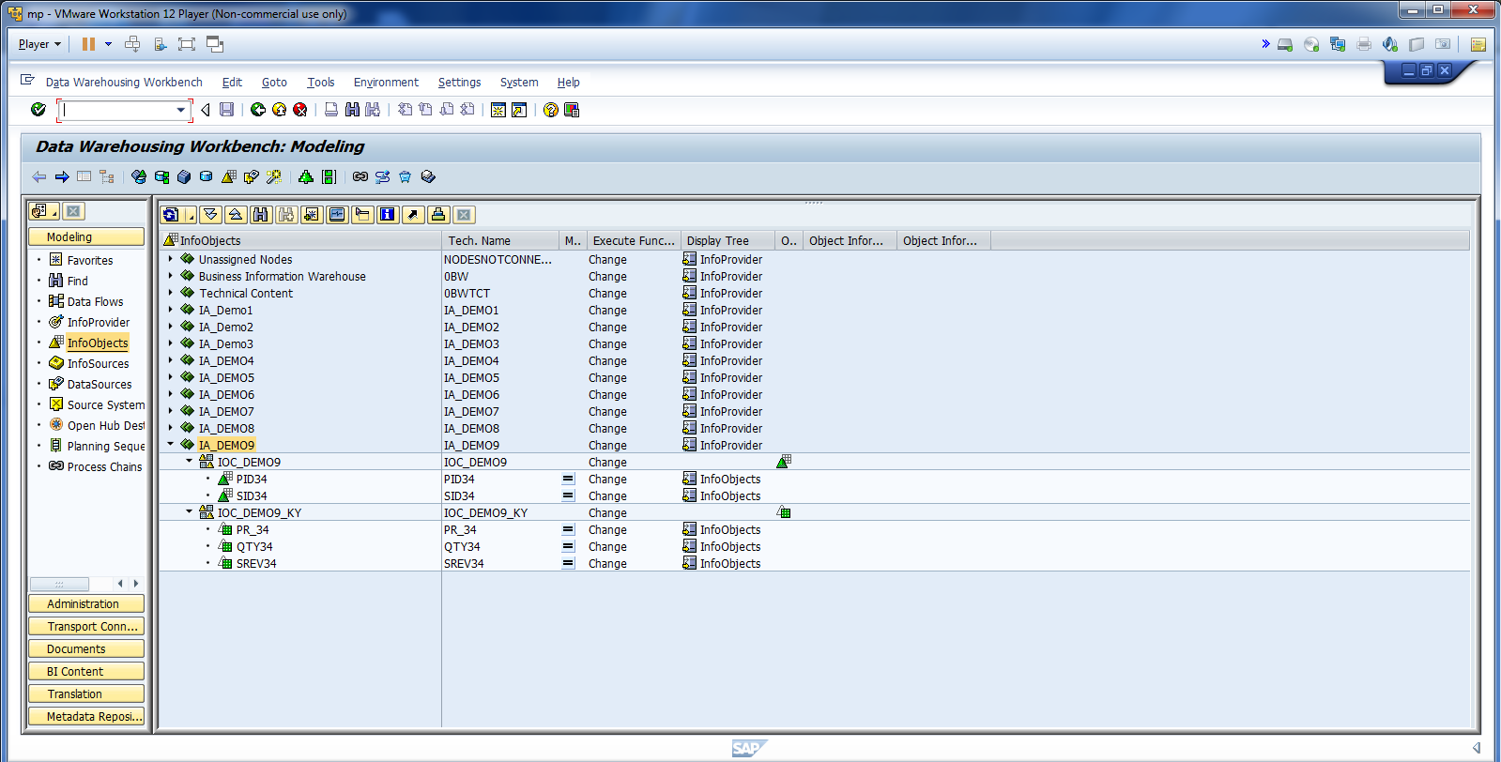
Demo 9 Pre-Requisites.

Slide 4
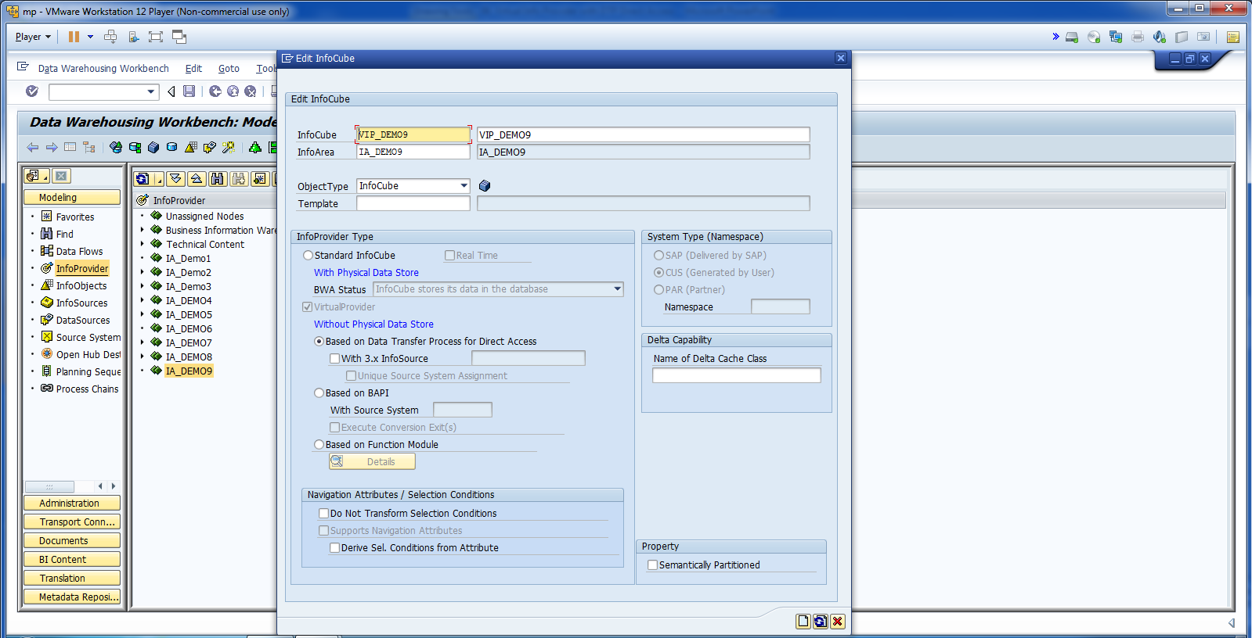
Create Virtual Info Provider.

Slide 5
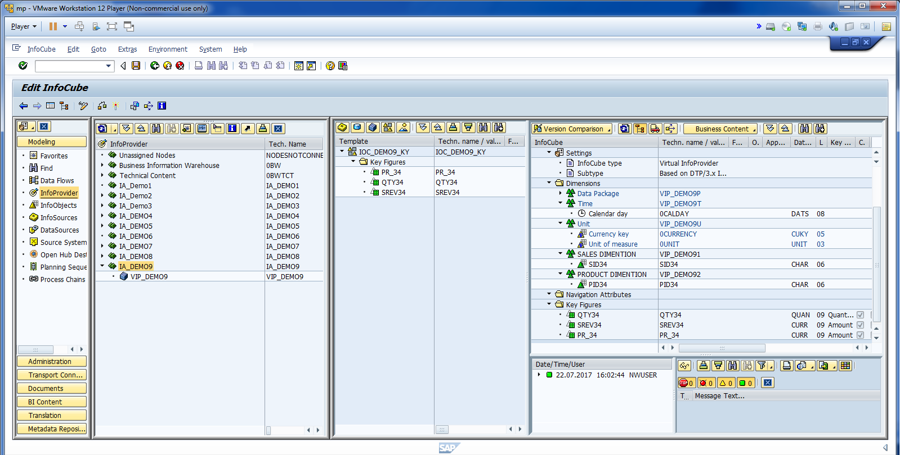
Cont.

Slide 6
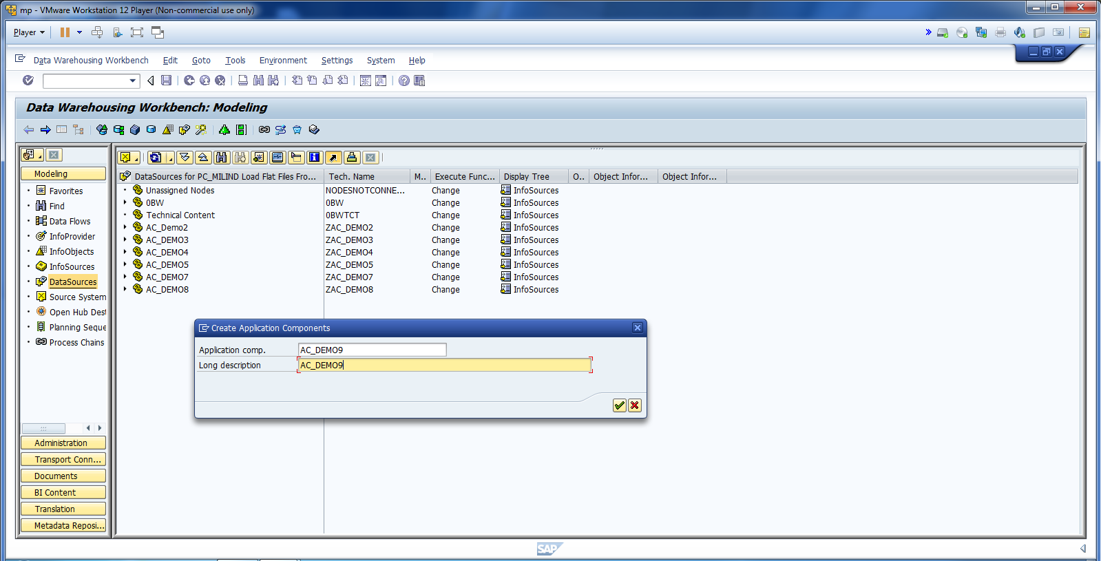
Create Data Source.

Slide 7
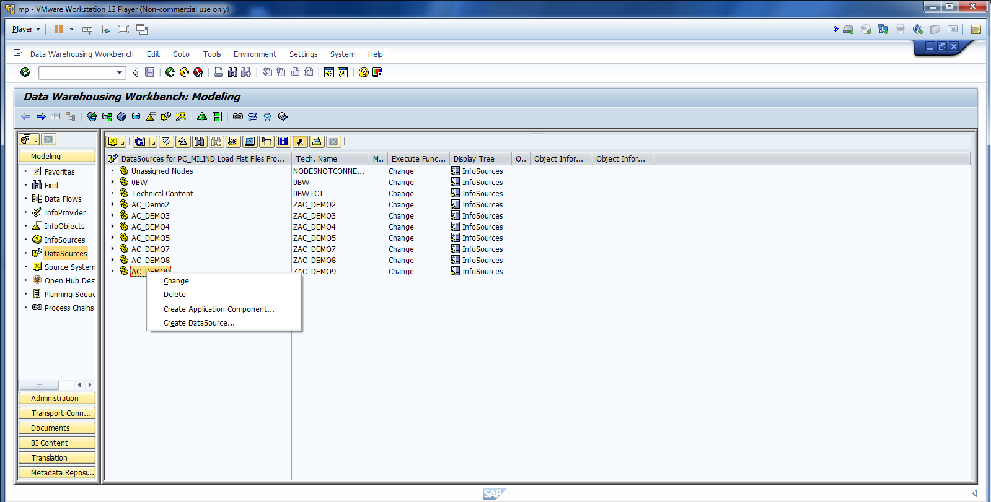
Cont.

Slide 8
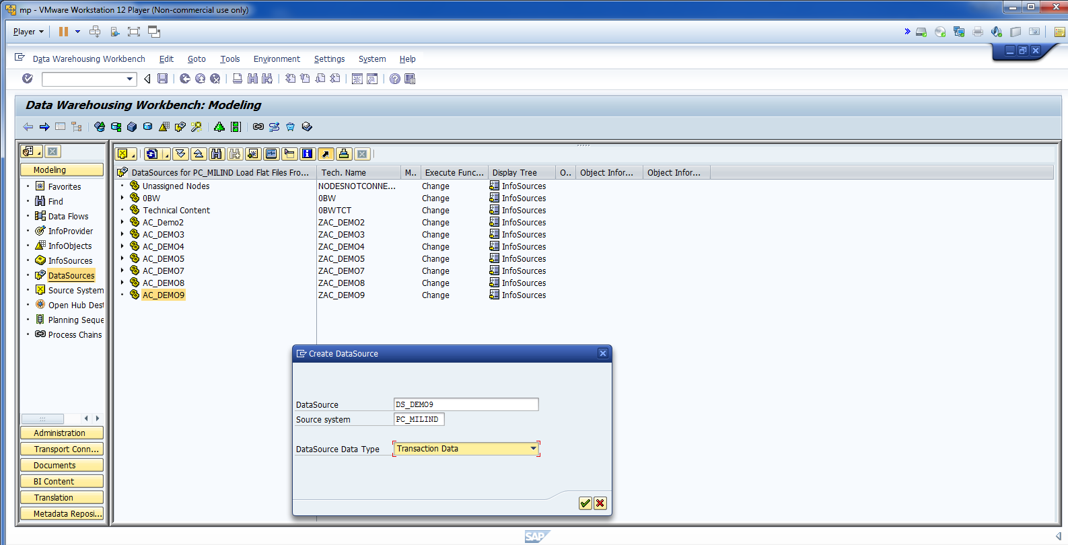
Cont.

Slide 9
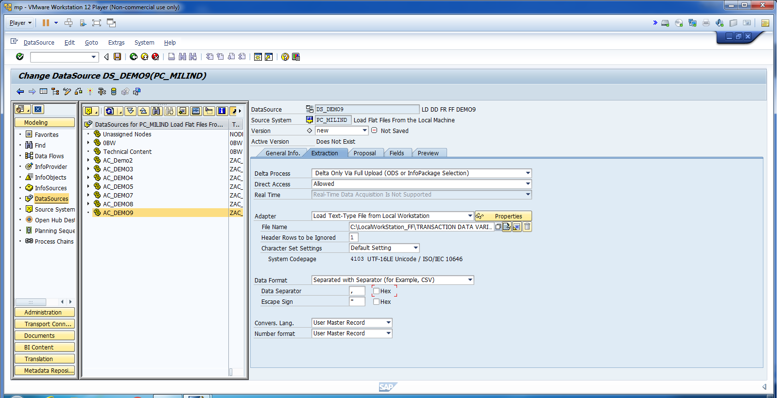
Change Direct Access: “Allowed” Update FF path.

Slide 10
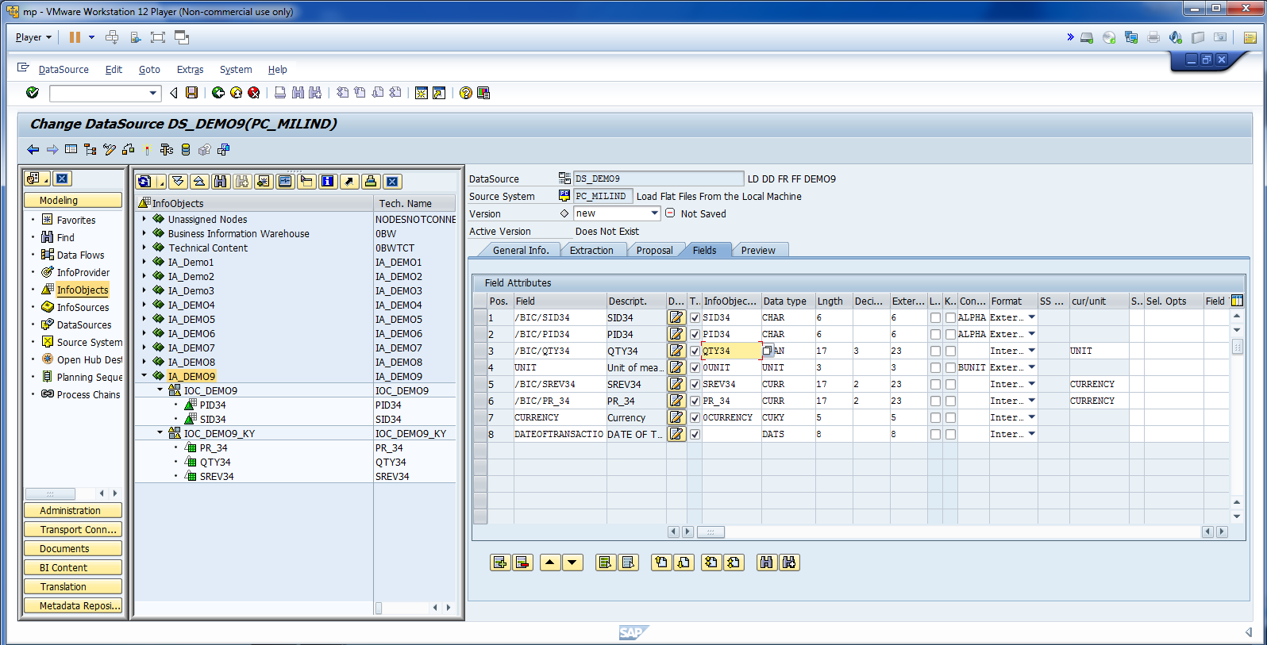
Cont.

Slide 11
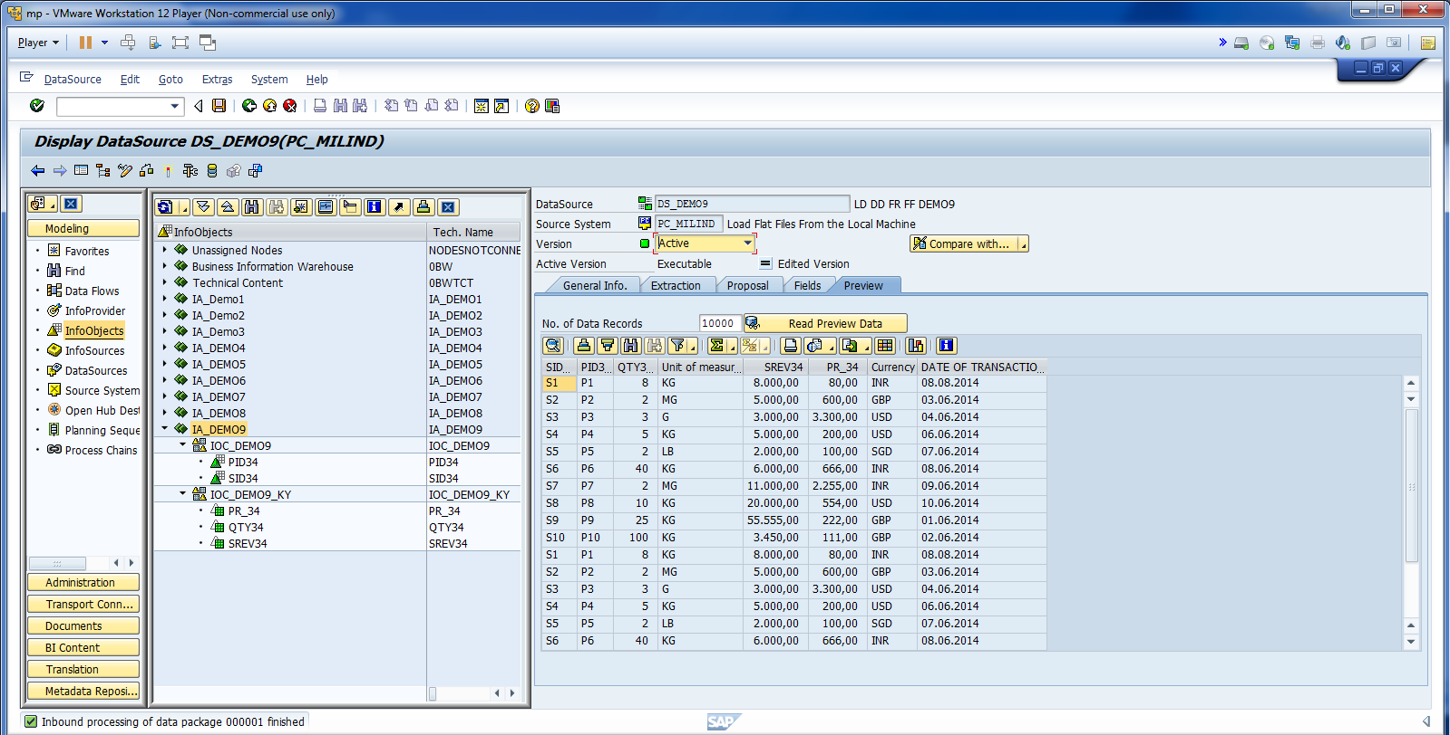
Cont.

Slide 12
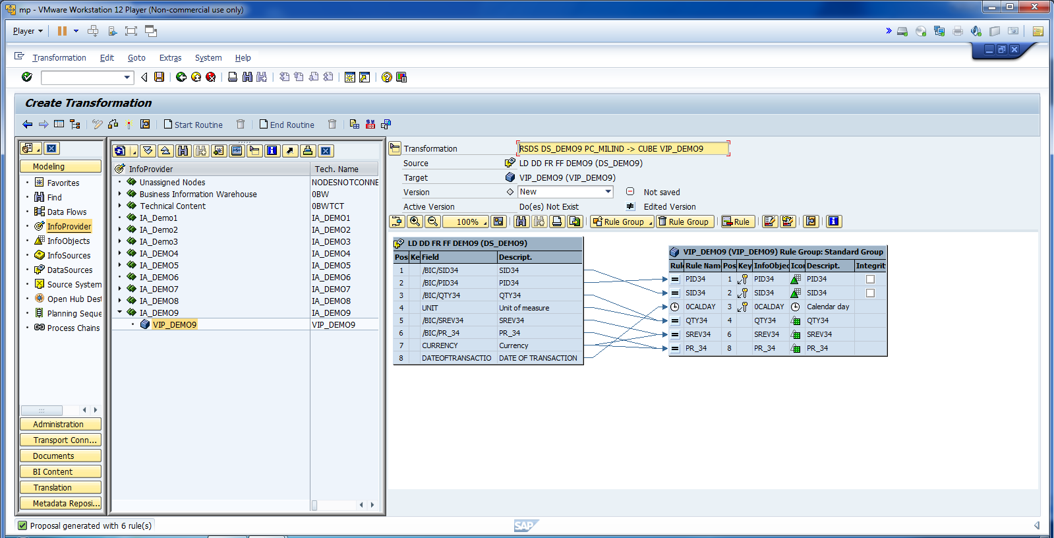
Check the Transformation.

Slide 13
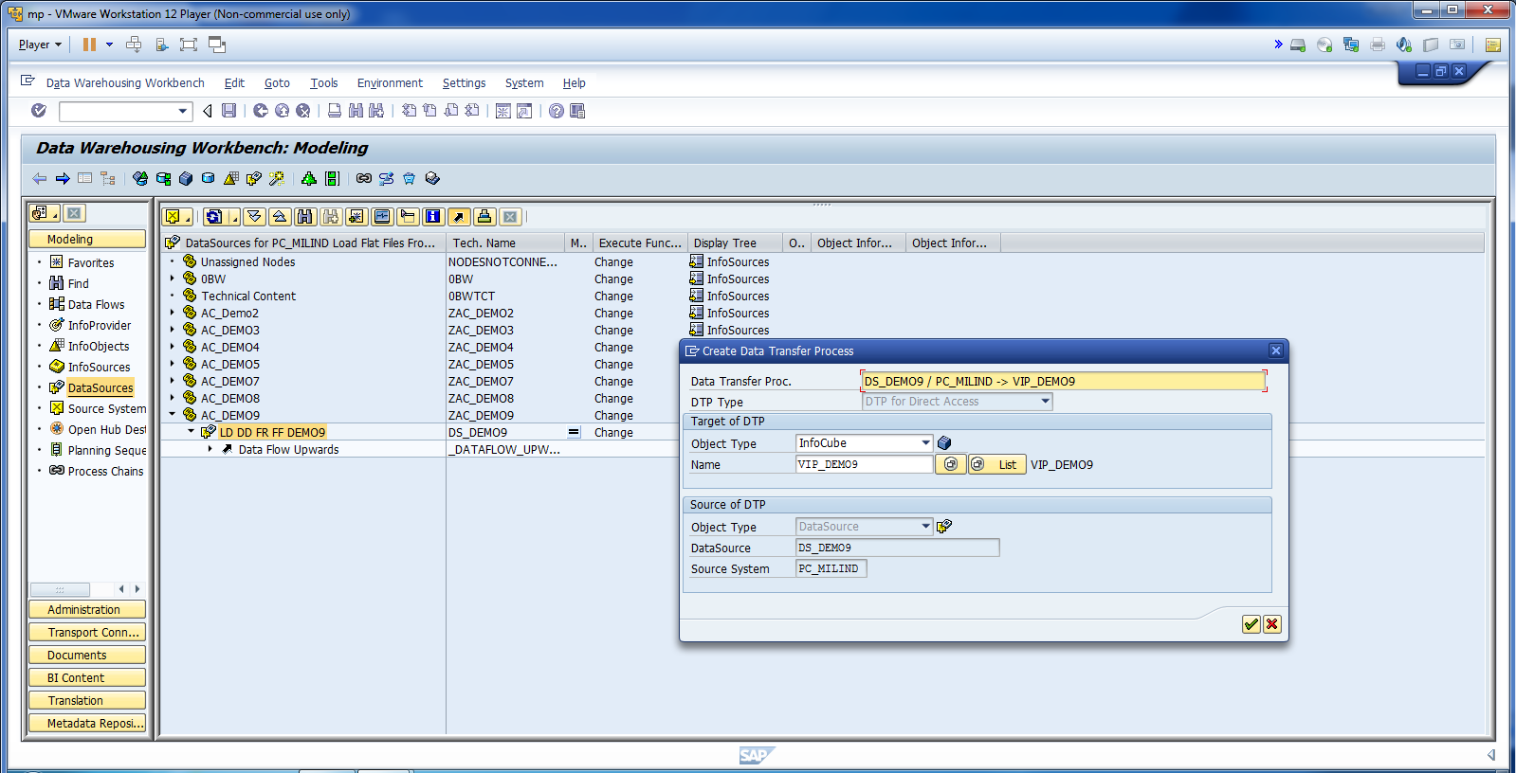
As this is direct access. No need to create Info Package.

Slide 14
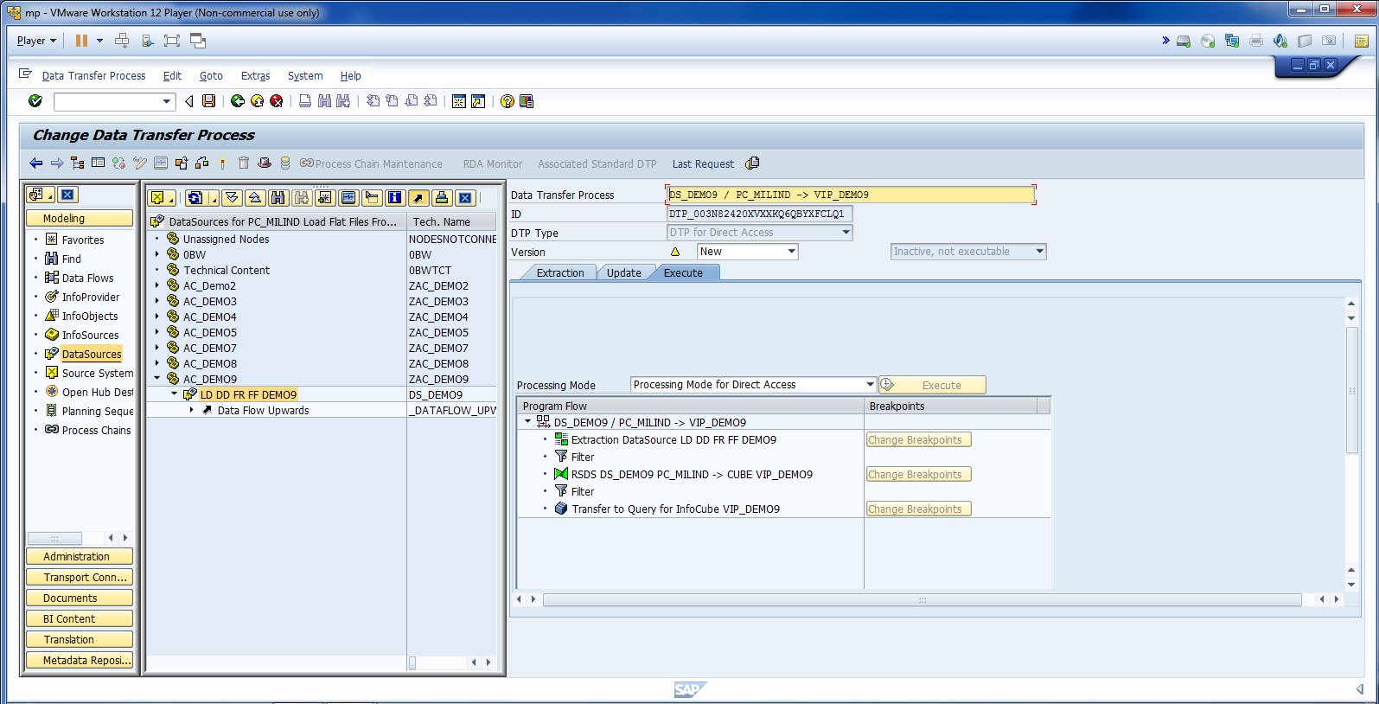
Activate DTP.

Slide 15
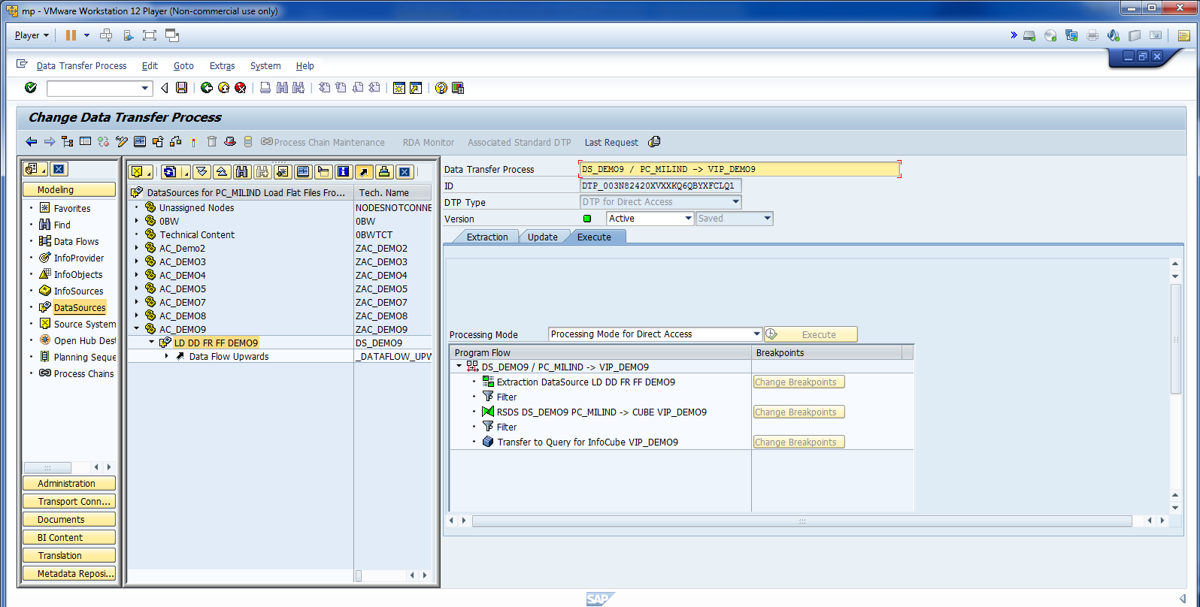
Check the Data in Virtual Provider.

Slide 16
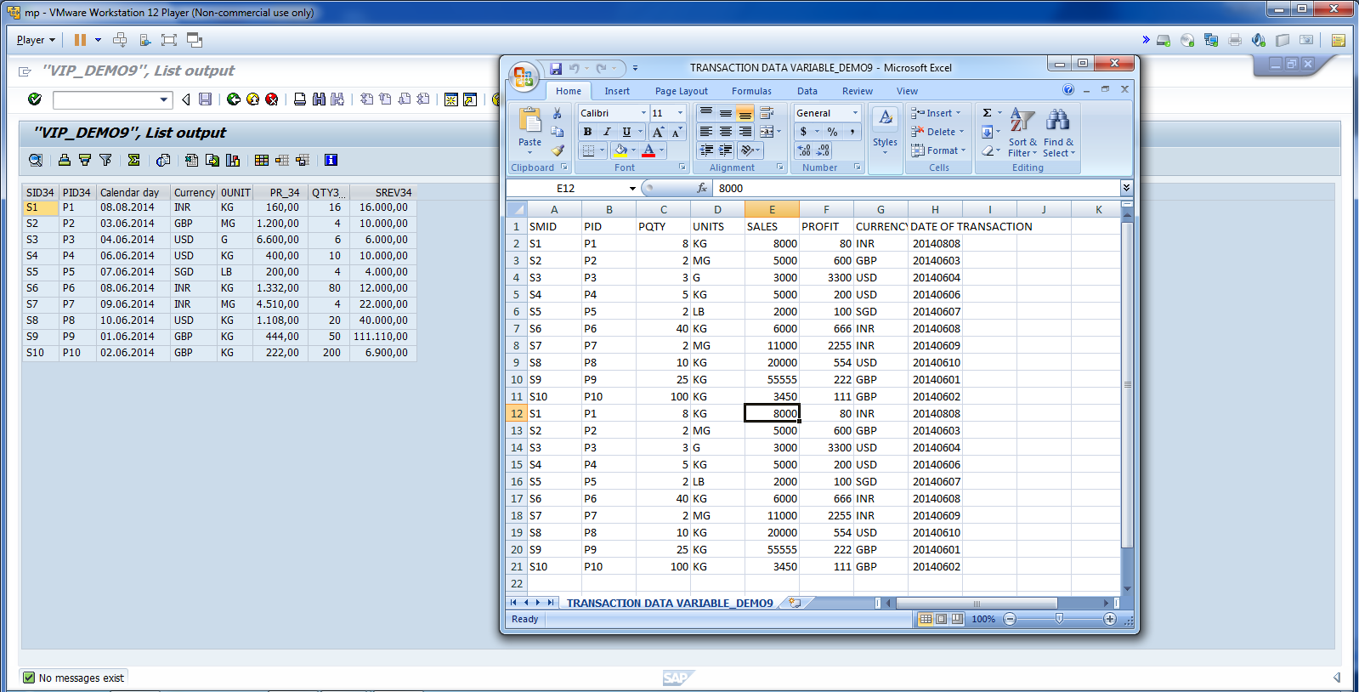
The data is loaded in Virtual Info Provider Successfully.

Slide 17
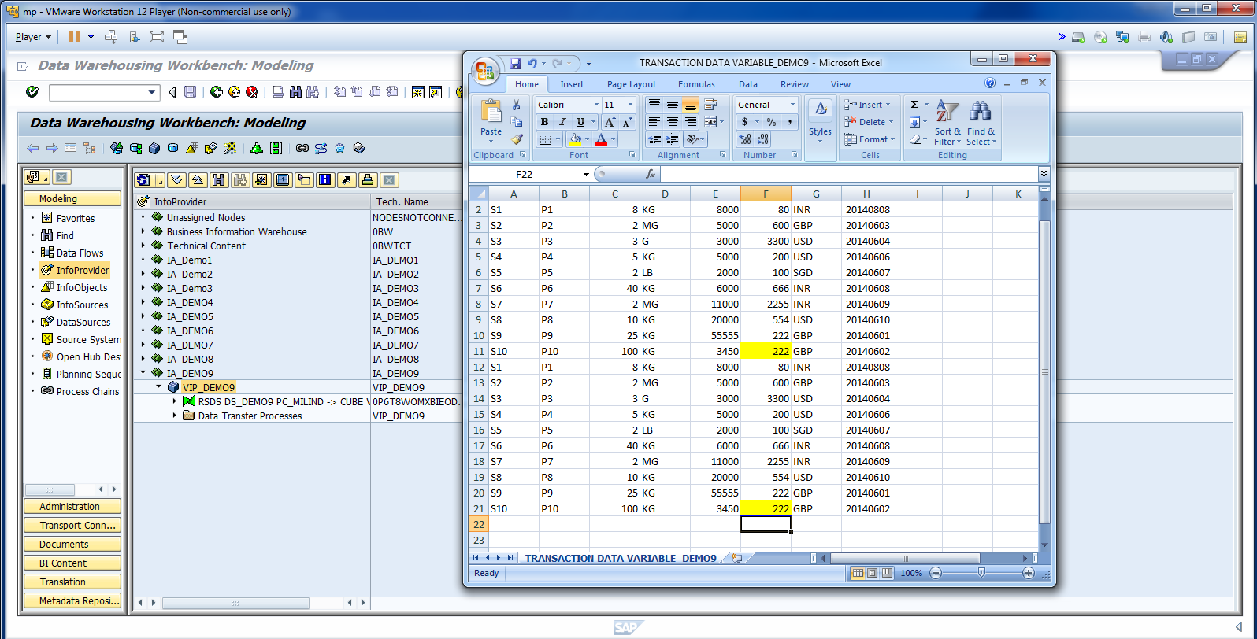
Let’s update FF.

Slide 18
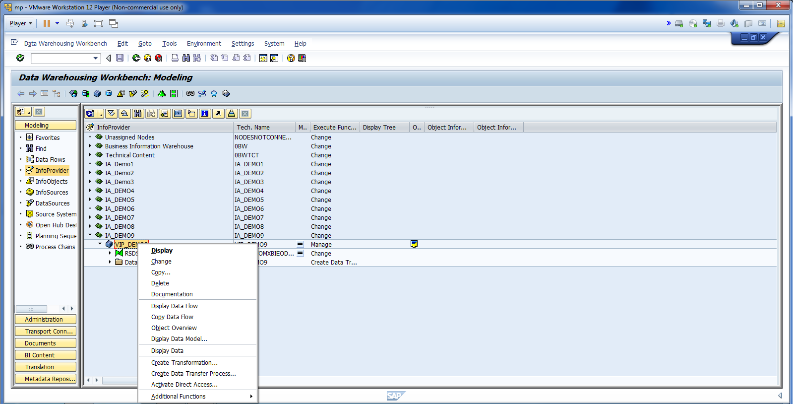
…and Click on Display Data.

Slide 19
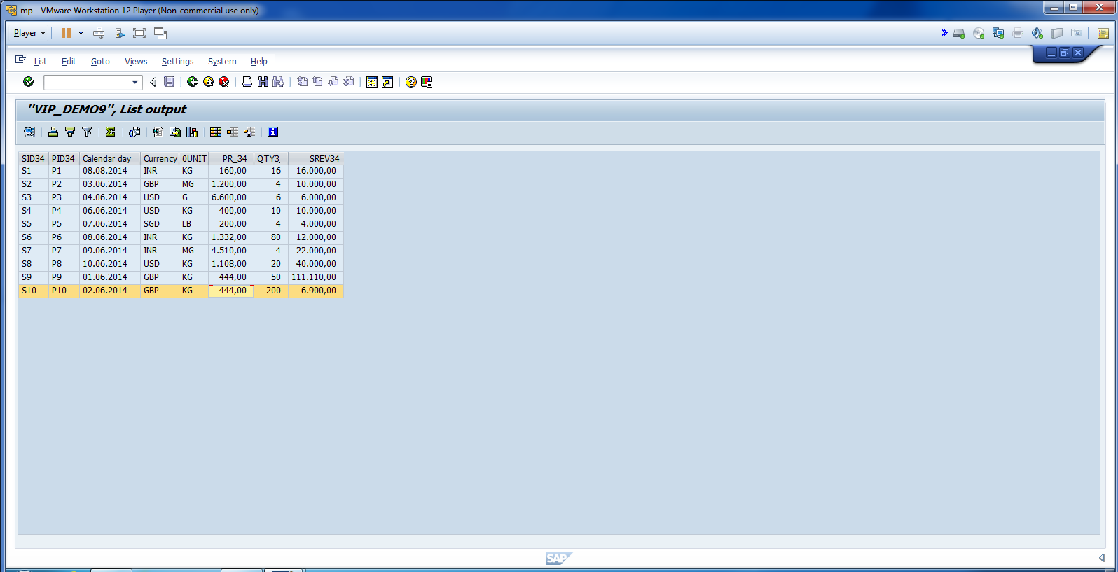
The value will be updated directly.

